Slide 1





TASK 2
Training problem

Slide 2


Group
Details
AMAN KUMAR SINGH
SANTHOSH.R
Y UDIT KUMAR
KATTA GOUTAM
MUDIREDDY TEJA

Slide 3


INDEX PAGE
INTRODUCTION
2. PROBLEM DEFINITION
3. FLOW CHART
4. INPUT/OUTPUT
5. ALGORITHM
6. FULL PROGRAM
7. SCREENSHOT
8. GIT HUB
9. CONTRIBUTION
10. THANK YOU

Slide 4

Introduction
Hi this is group 2 presenting you the training problem:
As the football coach at your local school, you have been tasked with picking a team of exactly P students to represent your school. There are N students for you to pick from. The i-th student has a skill rating Si, which is a positive integer indicating how skilled they are.
You have decided that a team is fair if it has exactly P students on it and they all have the same skill rating. That way, everyone plays as a team. Initially, it might not be possible to pick a fair team, so you will give some of the students one-on-one coaching. It takes one hour of coaching to increase the skill rating of any student by 1.
The competition season is starting very soon (in fact, the first match has already started!), so you'd like to find the minimum number of hours of coaching you need to give before you are able to pick a fair team.

Slide 5


2. Definition:
To make a fair team, we have to train the members of the team to the same skill level as the most skillful member of the team.
For any P students we pick, the time required to make a fair team is = Σ(max(Si, Si+1... SP) - Si), for all students i = 1 to P in the team. Our goal is to minimize this value.
One possible approach could be to go through all possible subsets of P students, from the given N students. But there exists NCP such subsets(here symbol C denotes Combination). Number of such subsets will be in the order of Factorial(N) and so enumerating through all of them will not fit within the time limit.

Slide 6
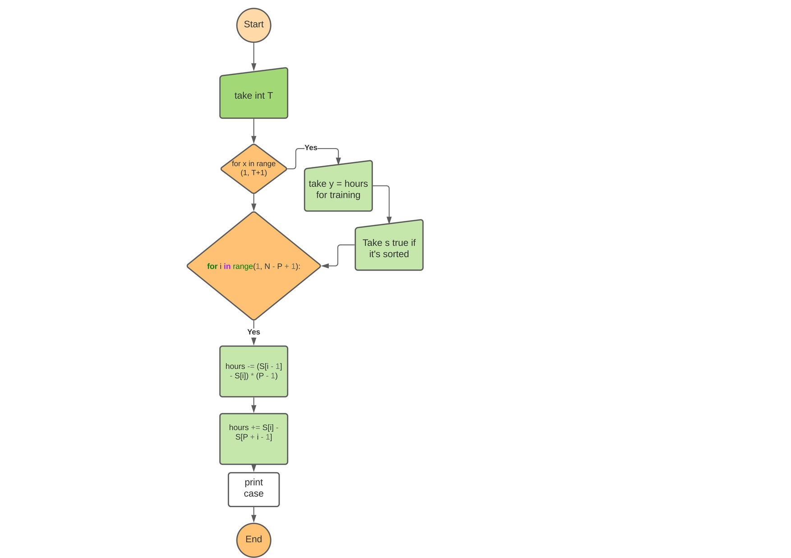

Flowchart:
1

Slide 7


INPUT/OUTPUT:
Input:
The first line of the input gives the number of test cases,T.Ttest cases follow. Each test case starts with a line containing the two integersNandP, the number of students and the number of students you need to pick, respectively. Then, another line follows containingNintegersSi; the i-th of these is the skill of the i-th student.
Output:
For each test case, output one line containingCase #x: y, wherexis the test case number (starting from 1) andyis the minimum number of hours of coaching.
SAMPLE:
input:
3
4 3
3 1 9 100
6 2
5 5 1 2 3 4
5 5
7 7 1 7 7
output:
Case #1: 14
Case #2: 0
Case #3: 6

Slide 8



Algorithm
we need to pick up 3 players we look up the sum array sum[3]
check the sum of three elements (sum[3]-sum[0]).
In general we range j from p-1 to n-1 and find s=sum[j+1]-sum[j-(p-1)].
( This gives me the sum of p elements in skill array).
Now, to find the training cost we select a[j] ( the highest element in the range) and
calculate trainingcost=(a[j]*p-s).
Result

Slide 9


Program:
T = int(input())
for x in range(1, T + 1):
N, P = map(int, input().split())
S = map(int, input().split())
S = sorted(S, reverse = True)
y = hours = sum(S[0] - s for s in S[:P])
for i in range(1, N - P + 1):
hours -= (S[i - 1] - S[i]) * (P - 1)
hours += S[i] - S[P + i - 1]
if hours < y:
y = hours
print("Case #{}: {}".format(x, y), flush = True)

Slide 10

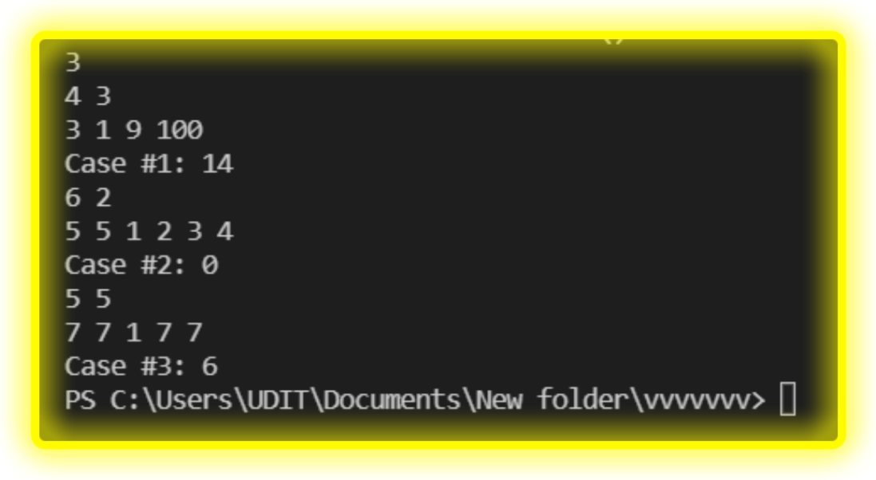

Output
Screenshot:

Slide 11
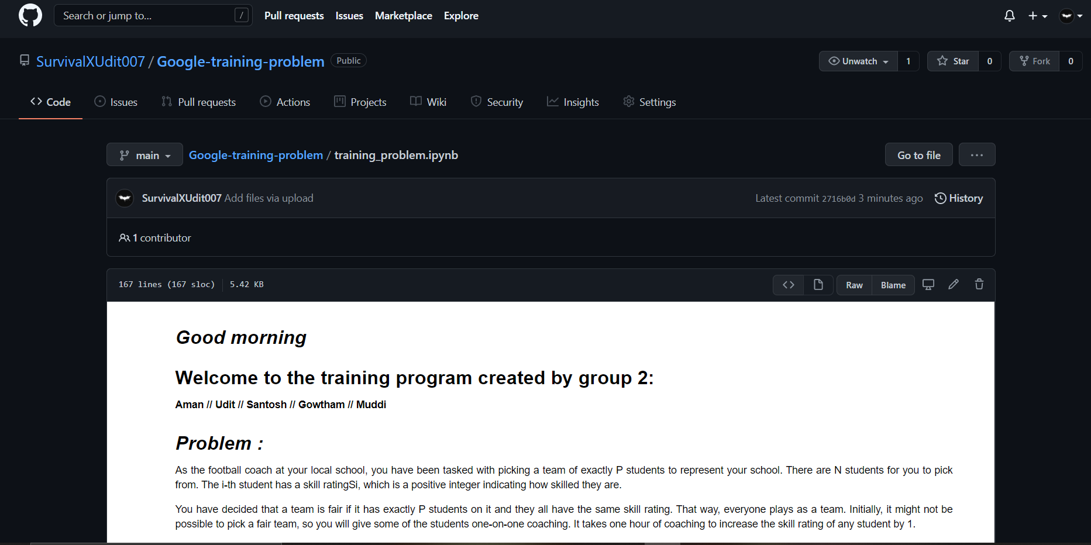
GitHub screenshot

Slide 12
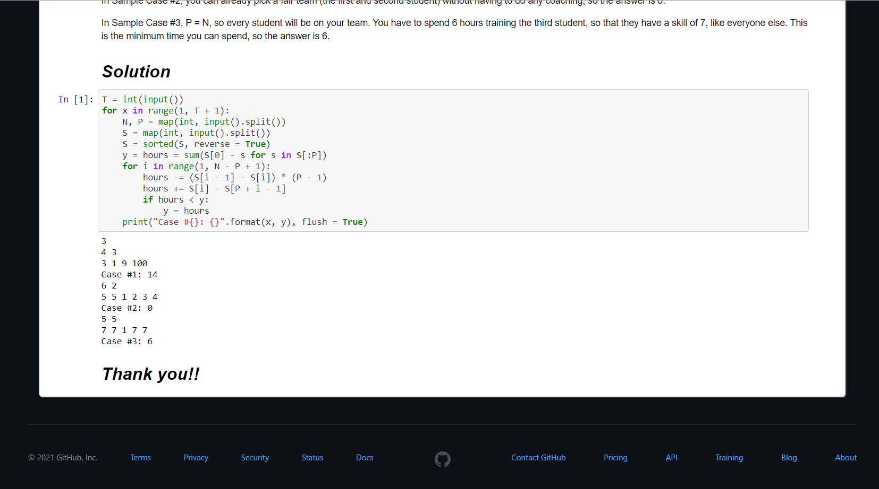

Slide 13

Contribution
M1
M2
M3
M4
Aman
Santosh
Udit
Katta gowtham
M5
Muddi reddy

Slide 14



Thank you!

